Slide 1
Solving Recurences
Three methods
-Recursion Tree Method
-Masters Theorem
-Substitution Method
L2.<number>

Slide 2
Recursion Tree Examples Solved
1. T(n)= 2 T(n/2) + cn
2. T(n)= 2 T(n/2) + cn²
3. T(n)= 4 T(n/2) + cn²
4. T(n)=3T(n/4) + n²
5. T(n)=4T(n/3)+n
6. T(n)= T(n/3) + T( 2n/3) + n
7. T(n)= aT(n/b) + f(n)
L2.<number>

Slide 3
The master method
The master method applies to monotonically increasing functions T(n) which are of the folllowing form
T(n) = a T(n/b) + f (n) ,
where a ≥ 1, b > 1, and f is asymptotically positive.
L2.<number>

Slide 4
Idea of master theorem
Recursion tree:
f (n)
f (n)
a
f (n/b)
f (n/b)
…
f (n/b)
a f (n/b)
a
h = log_{b}n
f (n/b²)
f (n/b²)
…
f (n/b²)
a² f (n/b²)
…
…
#leaves = a^{h}
= a^{logbn}
= n^{logba}
n^{logba}Τ (1)
Τ (1)
L2.<number>

Slide 5
Idea of master theorem
Recursion tree:
f (n)
f (n)
a
f (n/b)
f (n/b)
…
f (n/b)
a f (n/b)
a
h = log_{b}n
f (n/b²)
f (n/b²)
…
f (n/b²)
a² f (n/b²)
…
…
n^{logba}Τ (1)
Τ (1)
L2.<number>

Slide 6
The master method
The master method applies to recurrences of the form
T(n)= + ∑
where a ≥ 1, b > 1, and f is asymptotically positive.
h
n^{logba}Τ (1)
a^{i} f (n/b^{i})
^{i=0}
L2.<number>

Slide 7
Three common cases
Compare f (n) with n^{logba}:
f (n) = O(n^{logba – ε}) for some constant ε > 0.
  f (n) grows polynomially slower than n^{logba} (by an n^{ε} factor).
Solution: T(n) = Θ(n^{logba}) .
CASE 1: The weight increases geometrically from the root to the leaves. The leaves hold a constant fraction of the total weight.
L2.<number>

Slide 8
Three common cases
Compare f (n) with n^{logba}:
Case 2: If f (n) = Θ(n^{logba} )
  f (n) and n^{logba} grow at similar rates.
  Solution: T(n) = Θ(n^{logba} lg n) .
L2.<number>

Slide 9
Three common cases (cont.)
Compare f (n) with n^{logba}:
f (n) = Ω(n^{logba + ε}) for some constant ε > 0.
  f (n) grows polynomially faster than n^{logba} (by an n^{ε} factor),
and f (n) satisfies the regularity condition that a f (n/b) ≤ c f (n) for some constant c < 1.
Solution: T(n) = Θ( f (n) ) .
L2.<number>

Slide 10
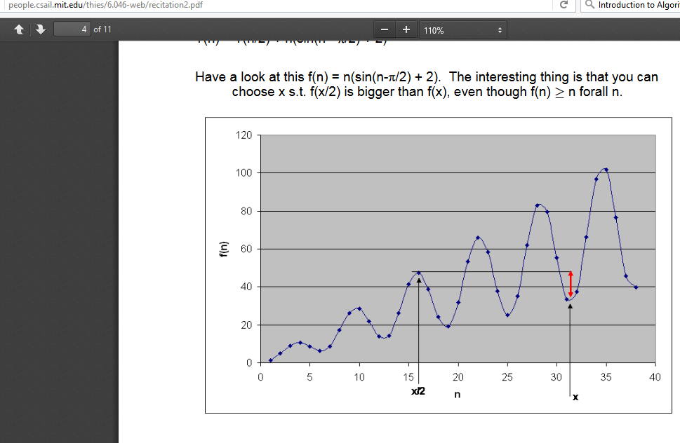
L2.<number>

Slide 11
Master Theorem Restrictions
- T(n) has to be monotonically increasing.
wont work on T(n)= sin x
- Has to be of form T(n) = a T(n/b) + f (n) ,
wont work on T(n) = a T(n/b) + cT(n/d) + f (n) ,
-- The constants a, b should be of form b>1 and a>=1
wont work on T(n) = T(n-2) +n
More of “wont work” -- T(n) = T ( sqrt(n))
L2.<number>

Slide 12
Examples
Ex. T(n) = 4T(n/2) + n
a = 4, b = 2 ⇒ n^{logba} = n²; f (n) = n.
CASE 1: f (n) = O(n^{2 – ε}) for ε = 1.
∴ T(n) = Θ(n²).
Ex. T(n) = 4T(n/2) + n²
a = 4, b = 2 ⇒ n^{logba} = n²; f (n) = n².
CASE 2: f (n) = Θ(n²lg⁰n), that is, k = 0.
∴ T(n) = Θ(n²lg n).
L2.<number>

Slide 13
Examples
Ex. T(n) = 4T(n/2) + n³
a = 4, b = 2 ⇒ n^{logba} = n²; f (n) = n³.
CASE 3: f (n) = Ω(n^{2 + ε}) for ε = 1
and 4(cn/2)³ ≤ cn³ (reg. cond.) for c = 1/2.
∴ T(n) = Θ(n³).
Ex. T(n) = 4T(n/2) + n²/lg n
a = 4, b = 2 ⇒ n^{logba} = n²; f (n) = n²/lg n.
Master method does not apply as not polynomially larger.
L2.<number>

Slide 14
Examples – Work Out
T(n) = T(2n/3) + 1
T(n) = 3T(n/4) + n lg n (log₄ 3)= 0.793)
T(n) = 4T(n/2) + n²
T(n) = 4T(n/2) + n³
T(n) = 2T(n/2) + n lg n
T(n) = 4T(n/2) + n²/lg n
L2.<number>

